Slide 1
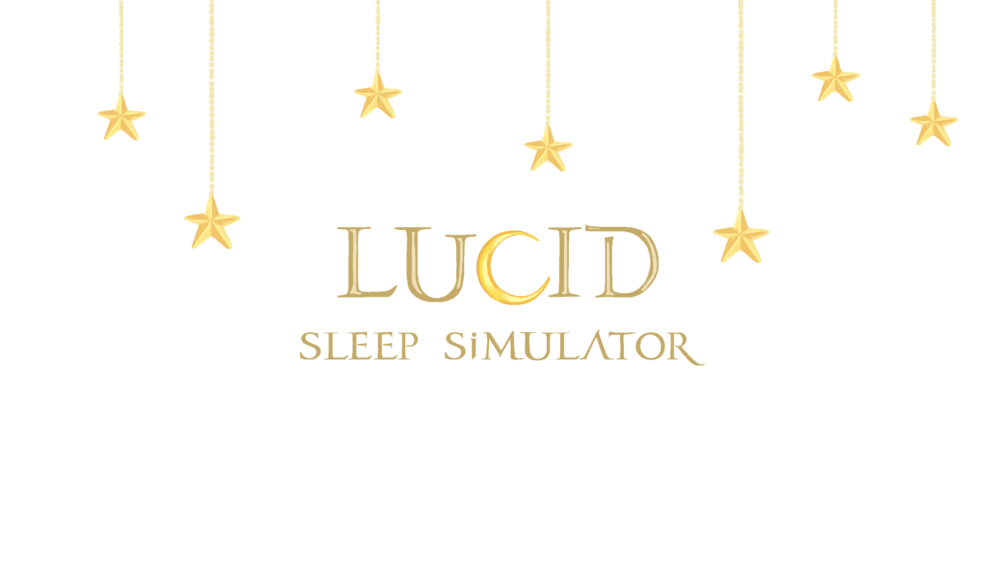
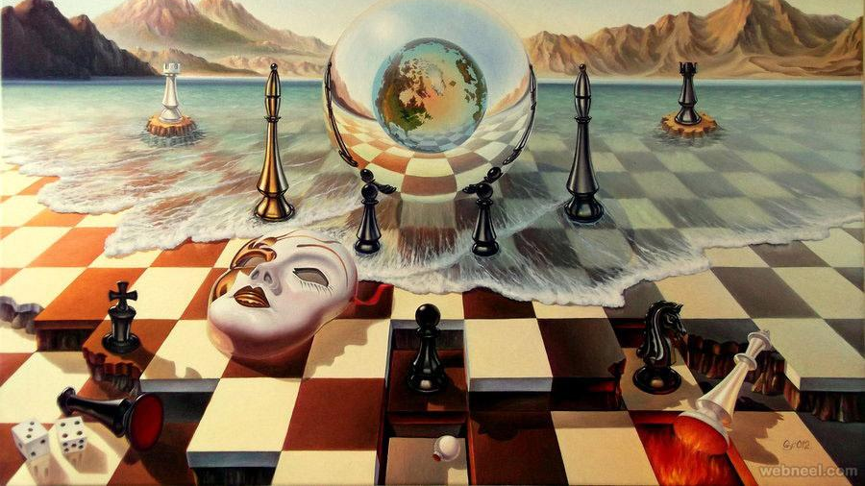

Slide 2
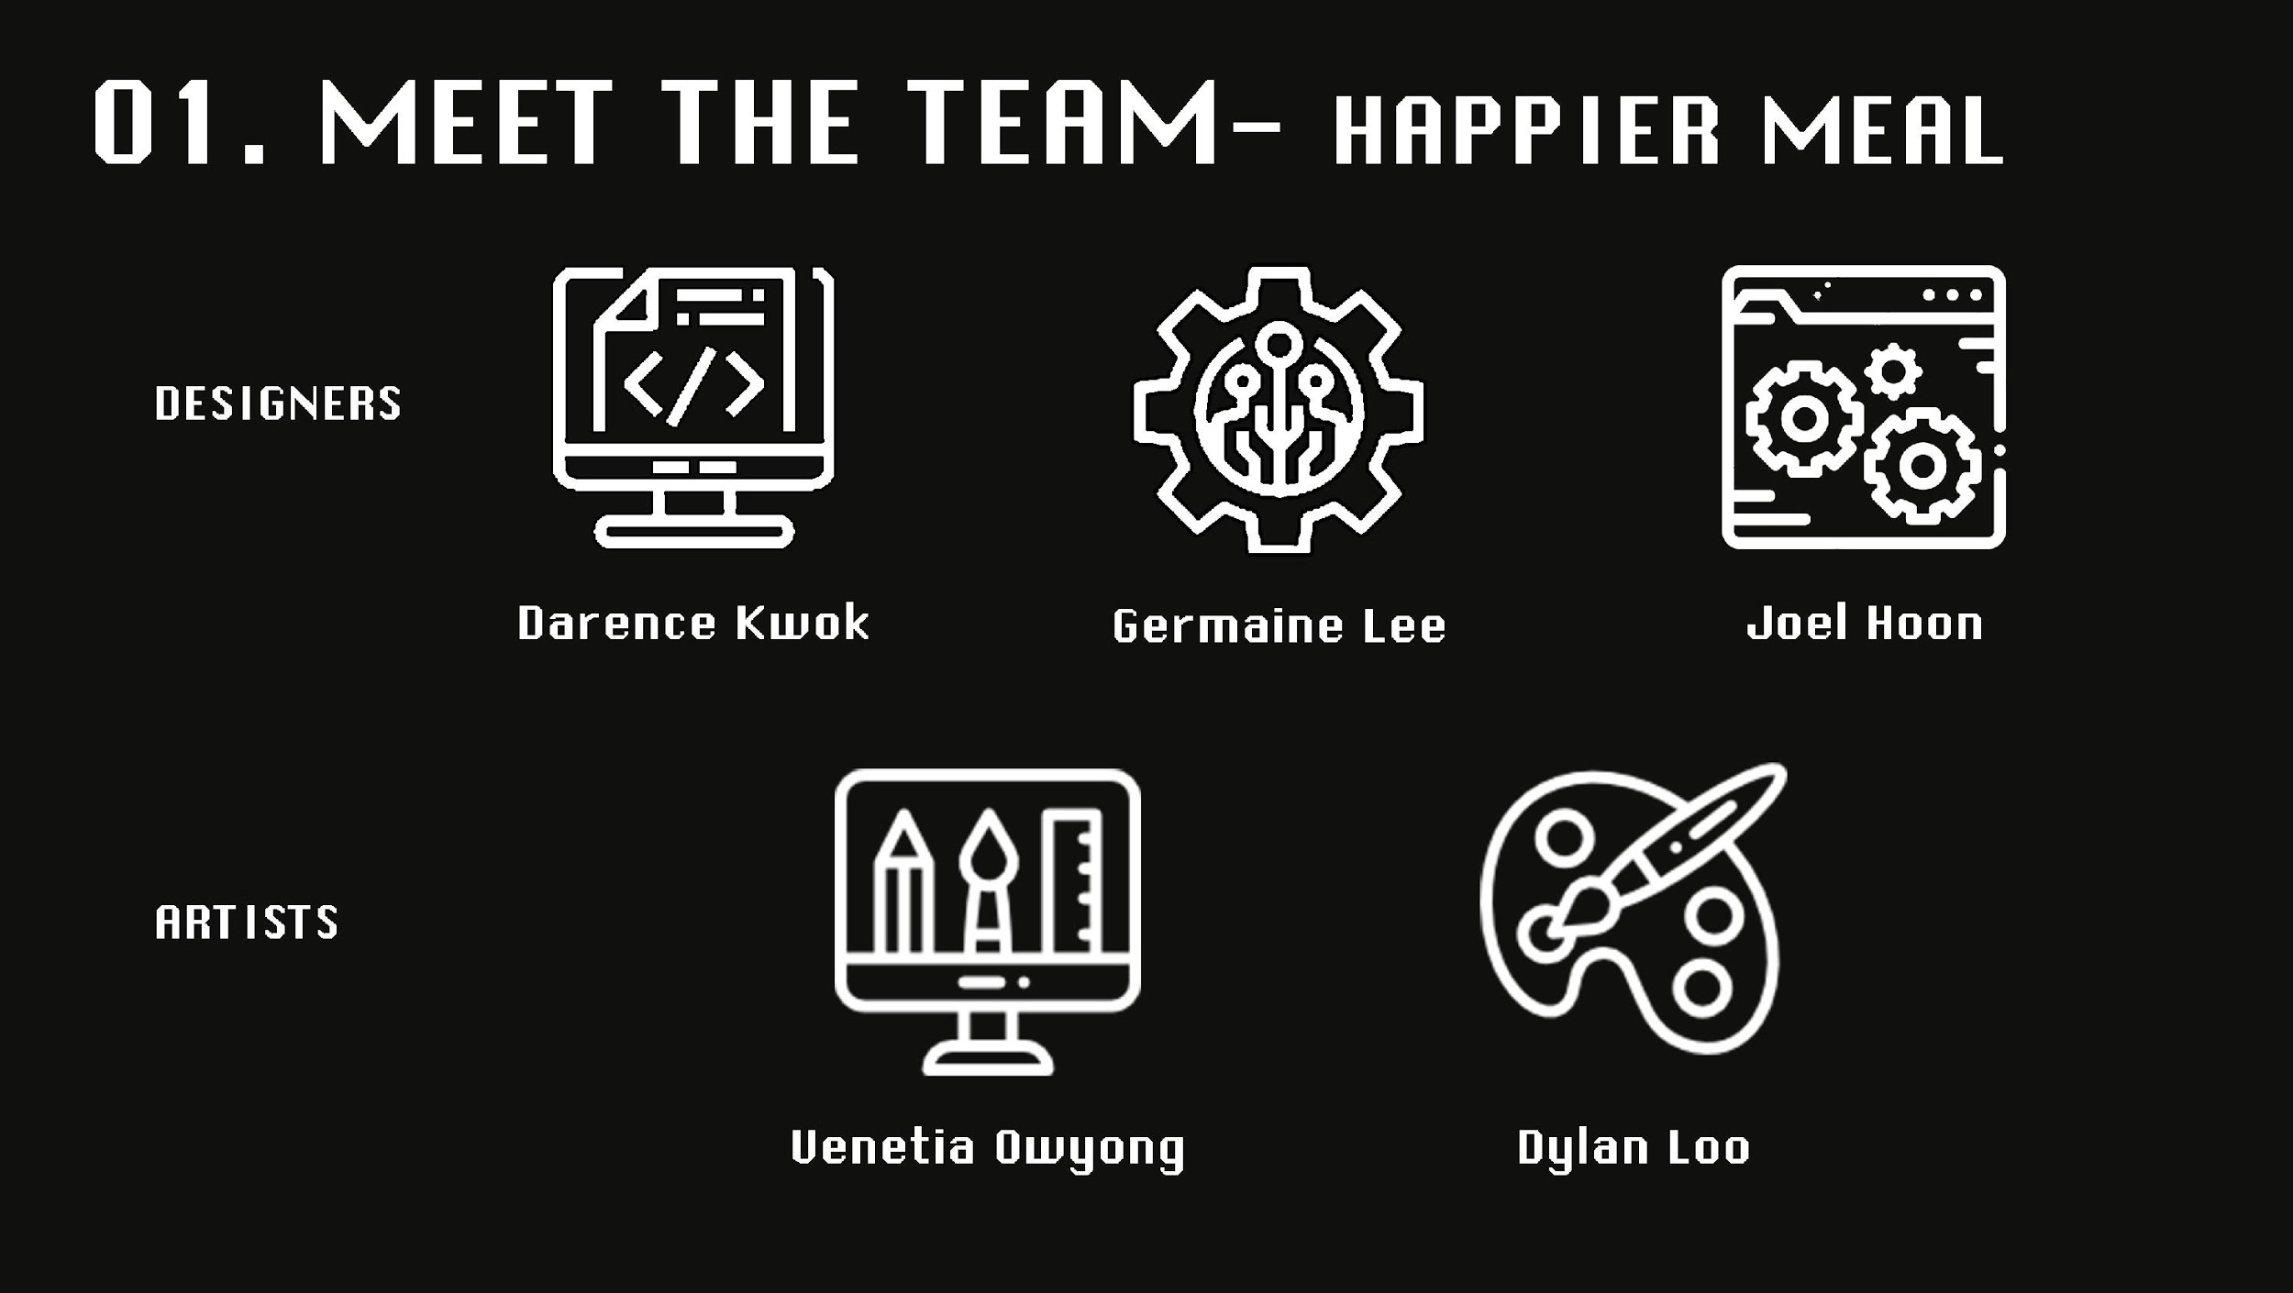
The Team

Slide 3
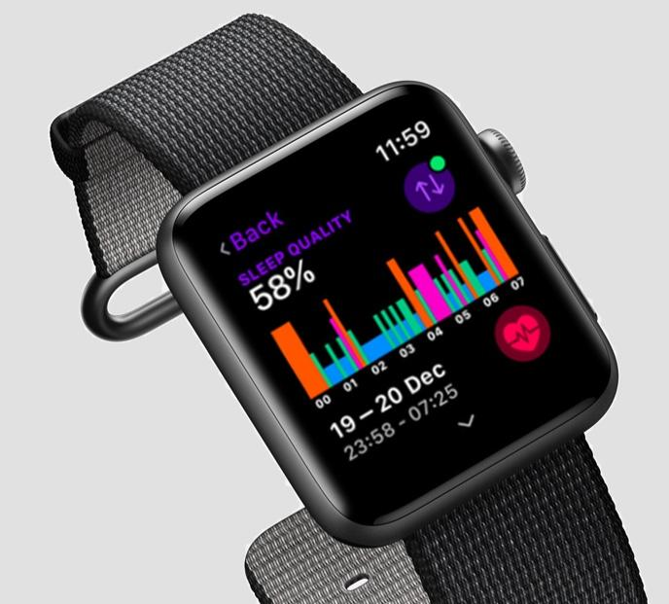
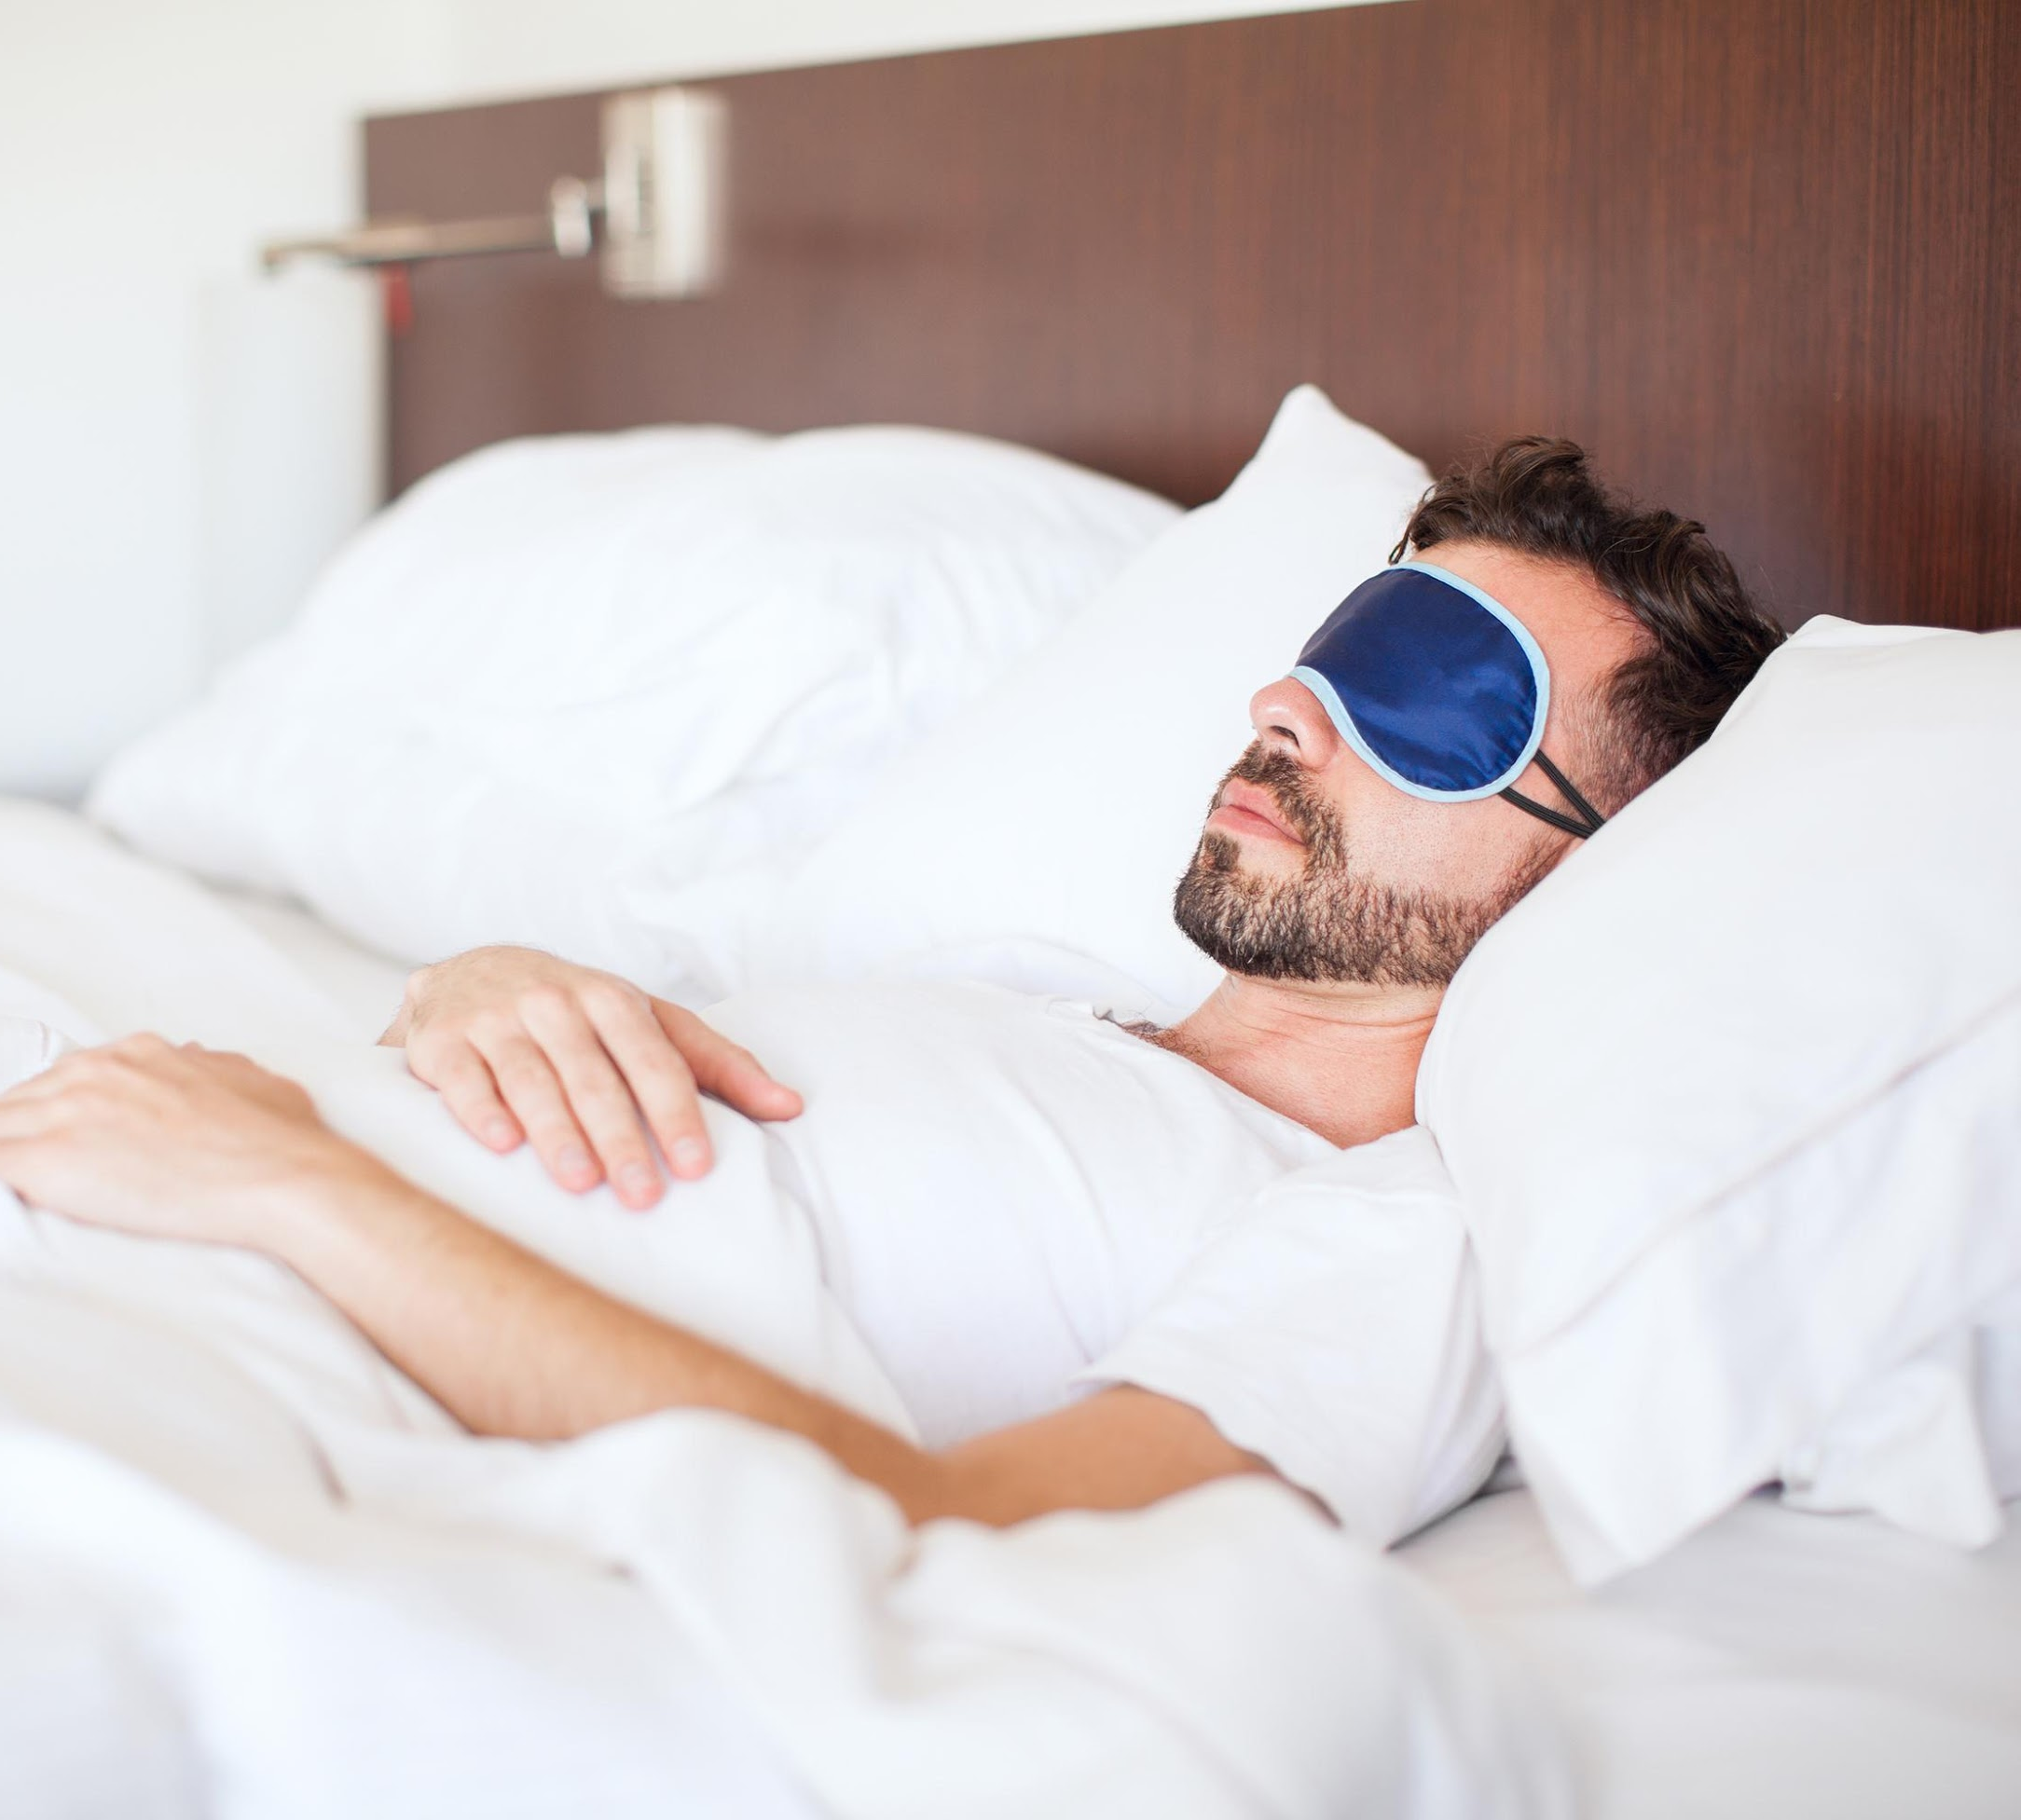
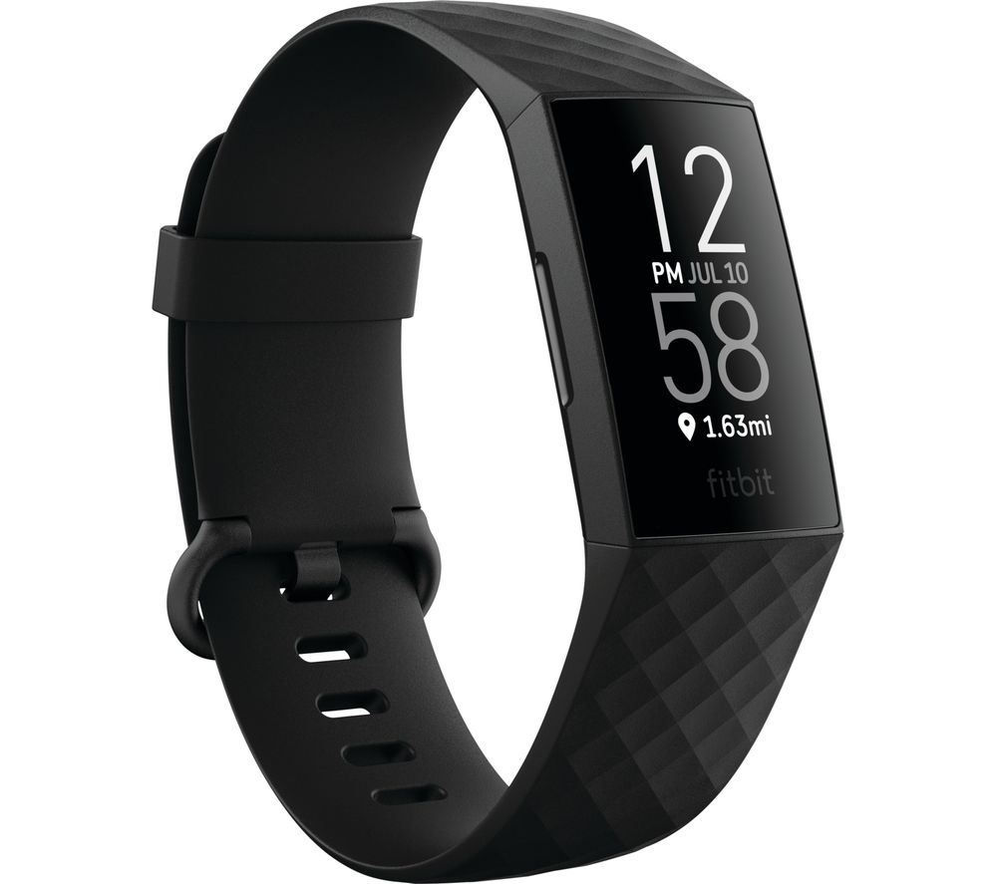
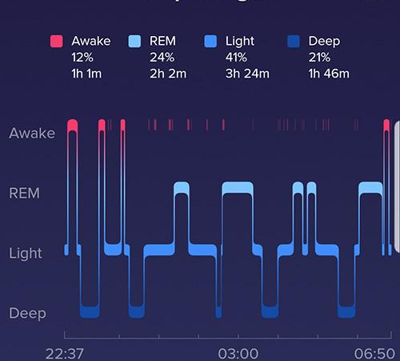
Fitness Tracking – Sleep Therapy
Tracks the user’s quality of sleep.
Provides detailed statistics.
Very scientific and highly contextual.

Slide 4
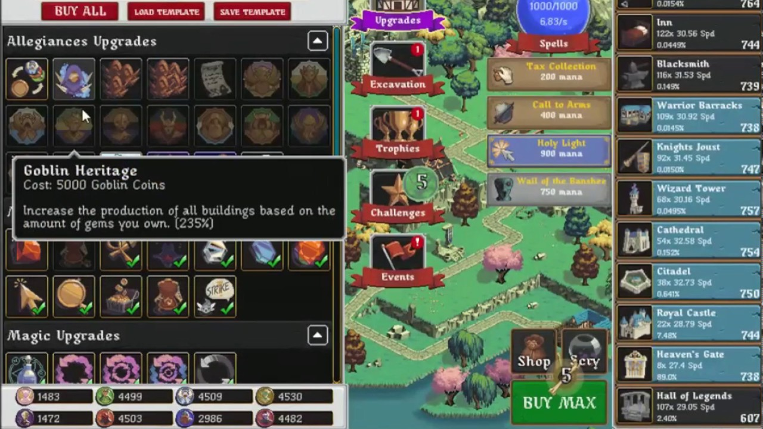
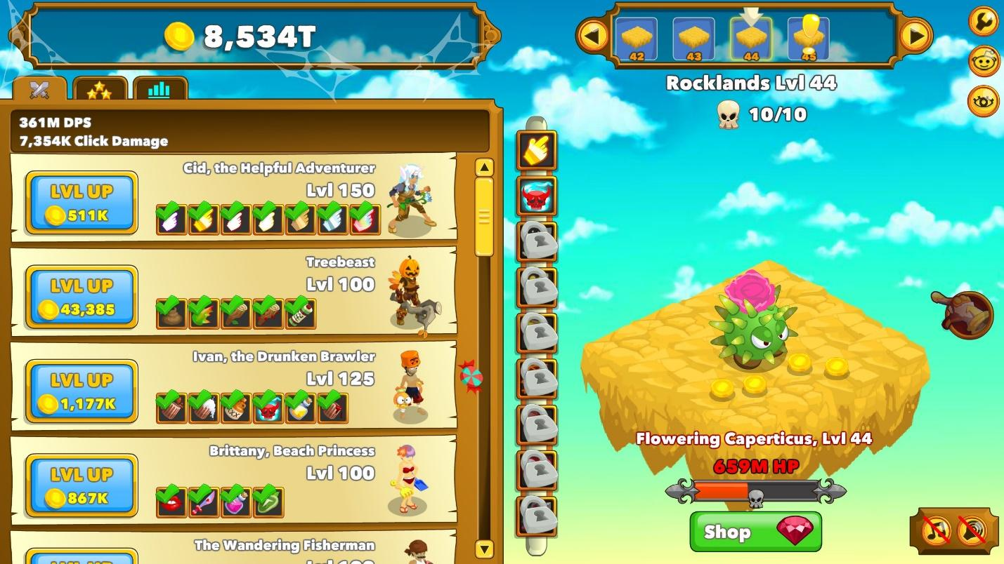
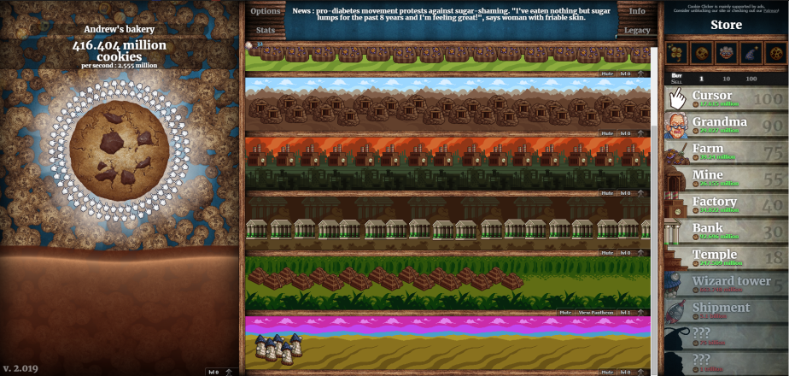
Idle Incremental Games
Cookie Clicker
Clicker Heroes
Forager

Slide 5
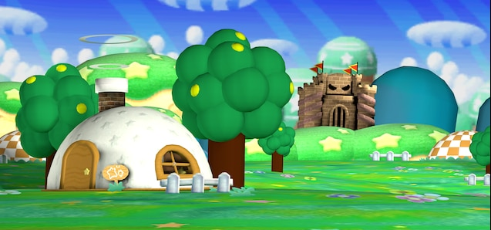

High Concept

Slide 6
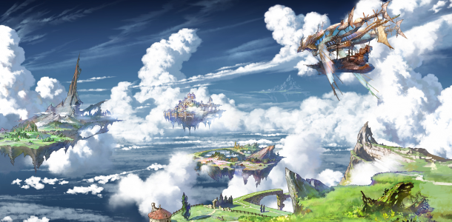
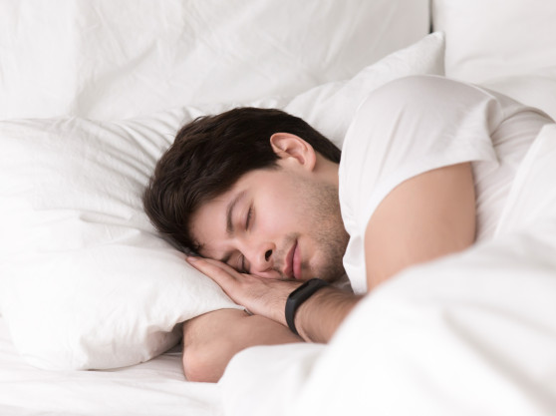
High Concept
Use the player’s sleep data to drive an interactive experience, making sleeping engaging.
Presents sleep statistics in a more visual and fun manner to the user.
Utilize engagement methods to motivate the user to sleep better to benefit their health.
Players are rewarded with progress in their game world with sleep.

Slide 7




Basic Game Flow
Player’s sleep data is used to gain dream points. Better sleep quality = More points.
Dream points can be used to build and upgrade the dream world, further increasing dream points gained in different ways.
During the day, player can interact with their dream world and attract new inhabitants to visit and stay. These all contribute to gaining dreams points as well.
Notes:
The flow of our app has a simple loop.
The main action for progression in the game is simply for the player to sleep, and the will be rewarded with points.
These points can be spent to upgrade and furnish their dream world, further increasing the points gained with bonuses and more sources of points.
Sleeping is not all there is to the game, as during the day time the player can interact with their world to play activities and further grow and manage it.
This creates a simple but engaging feedback loop, in which the player is constantly rewarded with positive growth and feedback for their interactions, as we want to create a motivating experience for sleep fitness instead of punishing or the user with negative reinforcement.

Slide 8
Game Loop
Sleep Phase
Upgrade Phase
Day Phase
Sleep
Gain Points
During Day
Gain Points Based on Sleep Quality
Build/Upgrade Buildings
Interact/Attract new Inhabitants
World Changes
Based on Dream Moods
Improve Inhabitants
Lives
Wake up - Log Dream and Mood
Interact with World/Day Time Activities
Notes:
Game loop is generally split into these 3 phases.

Slide 9
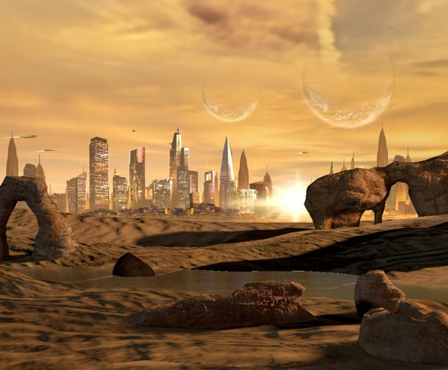
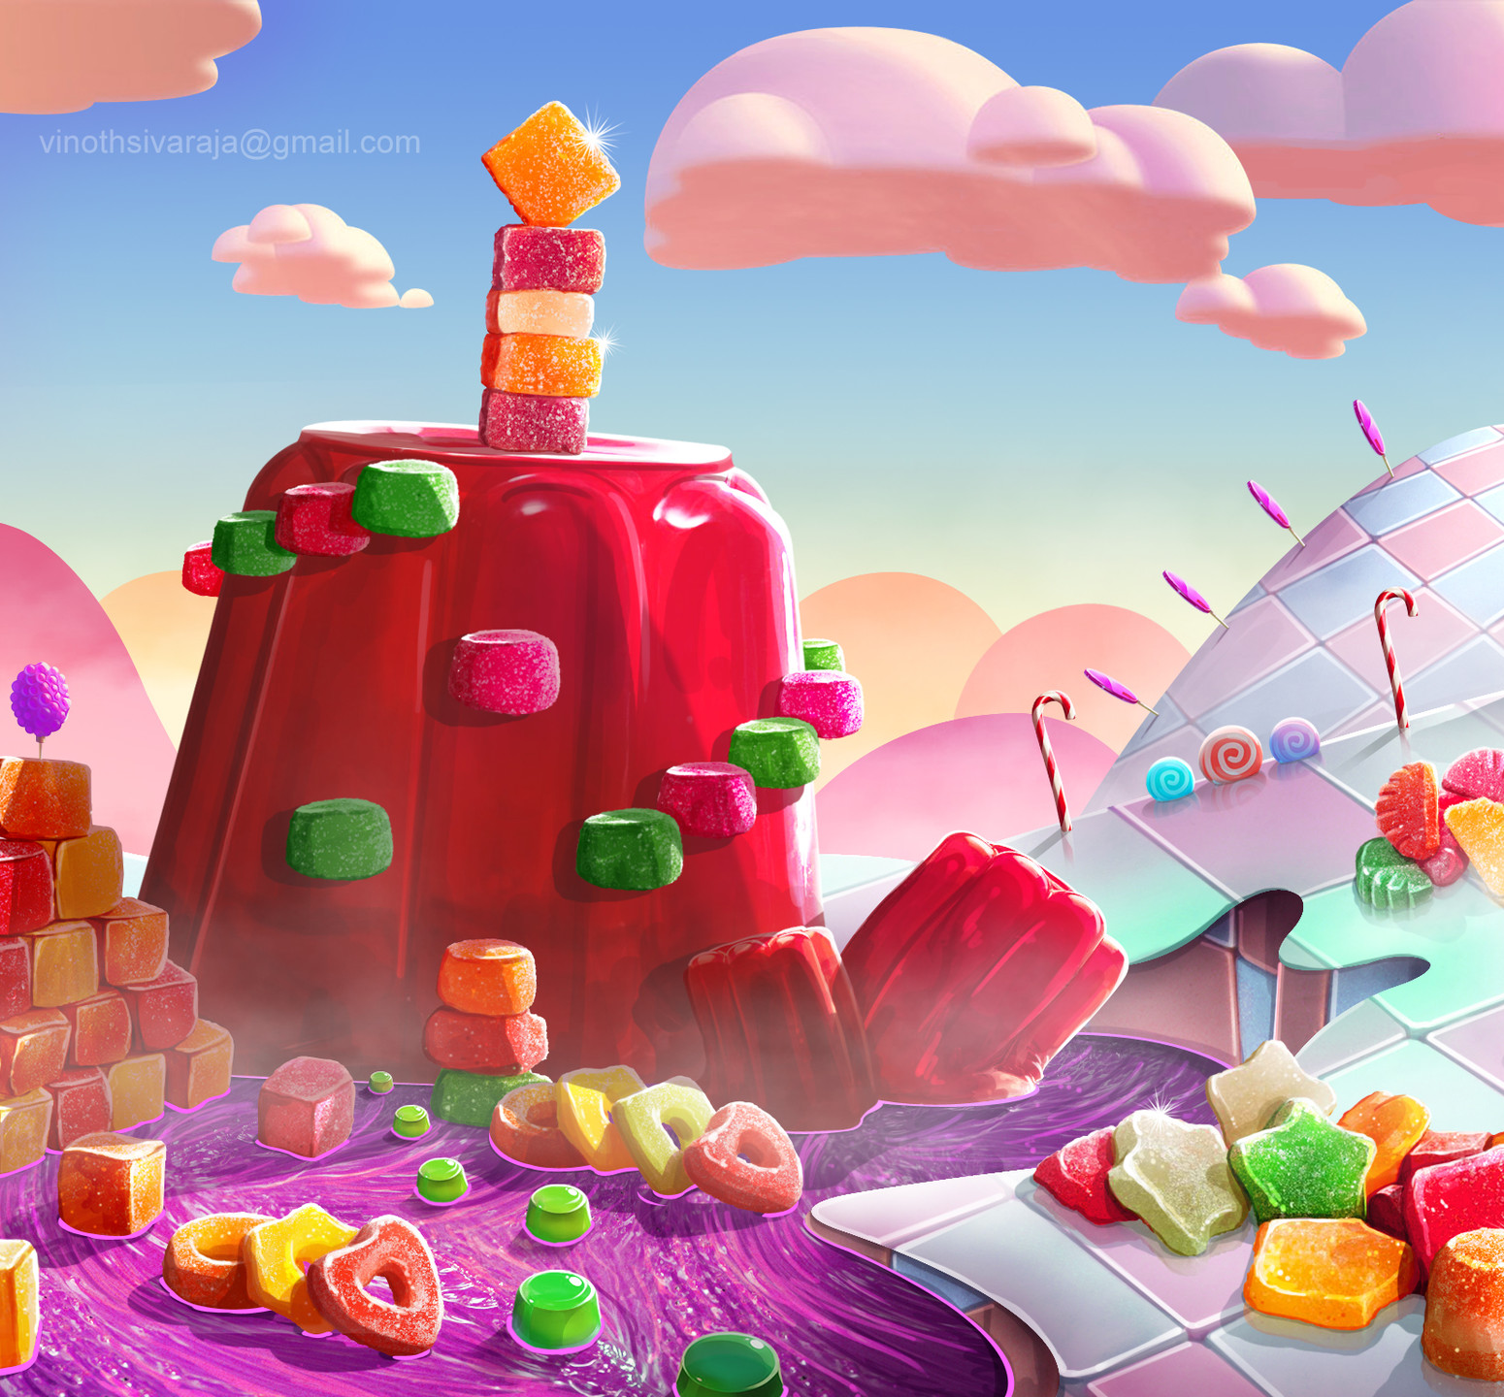
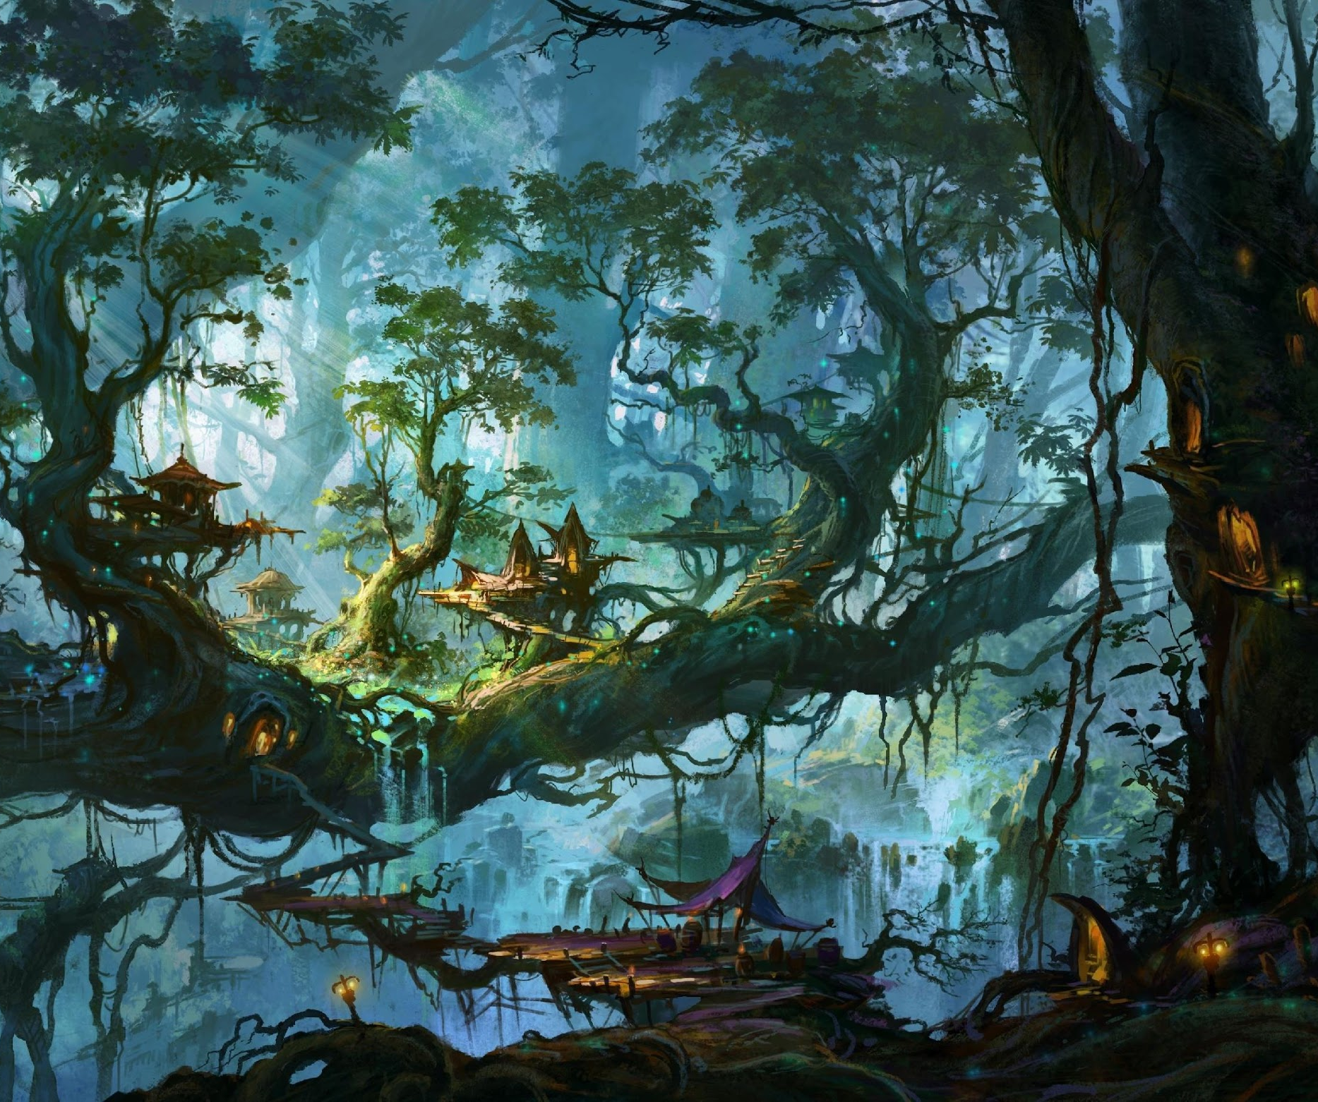
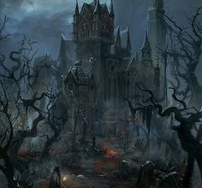
Mechanics / Progression
Dream Journal – World Environment
Every morning, the game will present a short questionnaire to the player about their dreams/sleep.
Player can note down details of dreams as well in a dream journal.
The answers will be then used by the game to alter the environment to suit the average mood of the player’s dreams.
Visual representation of connecting their in-game dream world to their real like dream world.
Notes:
The app has an integrated dream journal system that allows the world to alter the environment as it grows.
Every morning, the user will be presented with a word cloud to click on words they best feel represent what they dreamt, they can also optionally write down details and notes on their dreams and the app will record it into a timeline.
The environment will evolve and alter based on the user’s answers overtime, so the world will start to reflect the user’s dreams.

Slide 10
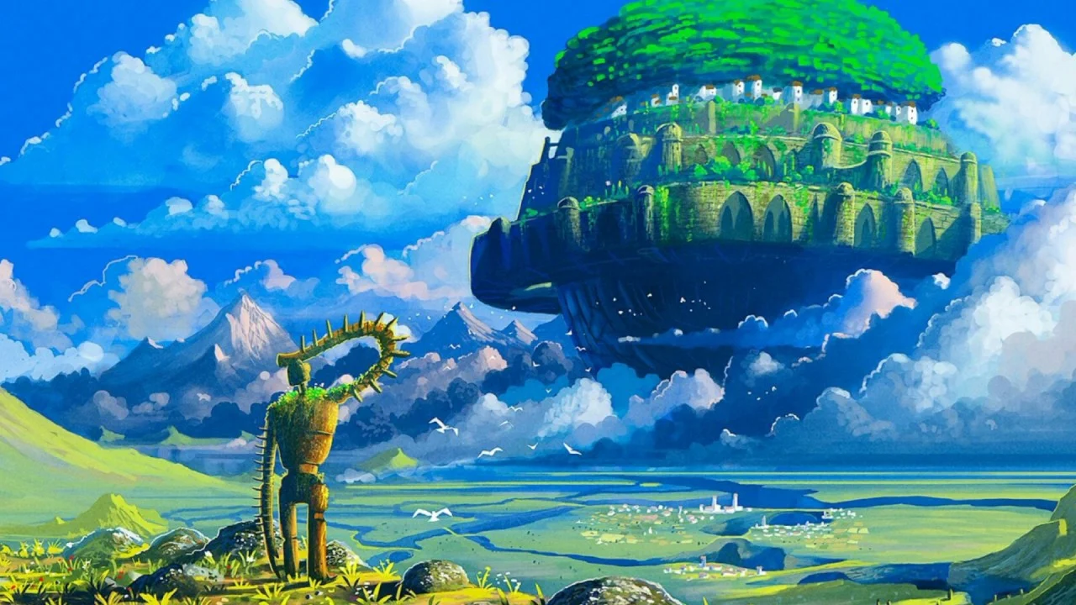
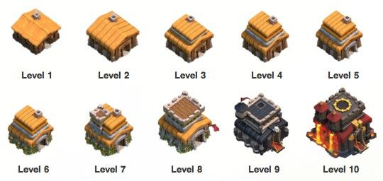
Mechanics / Progression
Structure Building/Upgrading
Player can build/upgrade structures in their world.
Structures have benefits such as:
Passive points generation
Grants points bonuses during activities/sleep
Provides day time activities for more points/growth
Attracting creatures (More on that later)
Notes:
The main form of progression in the game is to build and upgrade structures.
The player can populate their dream world with these structures which provides a variety of benefits and bonuses.
Most of them revolve around gaining more points, but some also help to unlock new day time activities for the player to engage in.
Some of the benefits are:
Passive points, where you get points overtime
Points bonuses that increases the rewards gained from sleep and activities
Unlocking activities
Attracting inhabitants

Slide 11


Example Structures
Factory
Dream Tree
Generates 10 dreams points every hour.
No player input needed; structure continuously generates points.
Grows up to 3 ‘dream fruits’ every few hours.
Player can harvest these fruits for bonus points.
Grants more points actively harvesting fruits than waiting for structures that passively generate points, to reward the user for active participation.

Slide 12
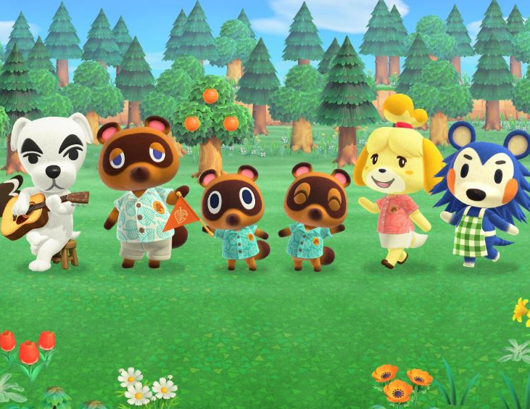
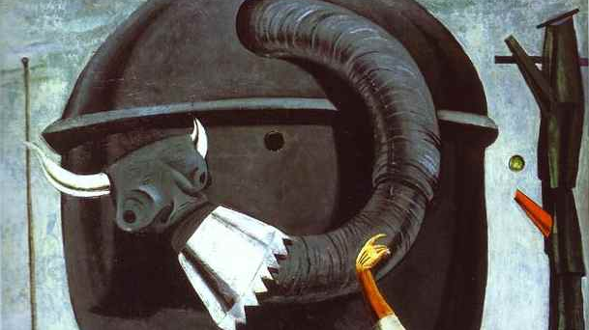
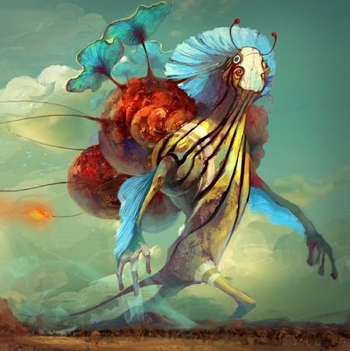
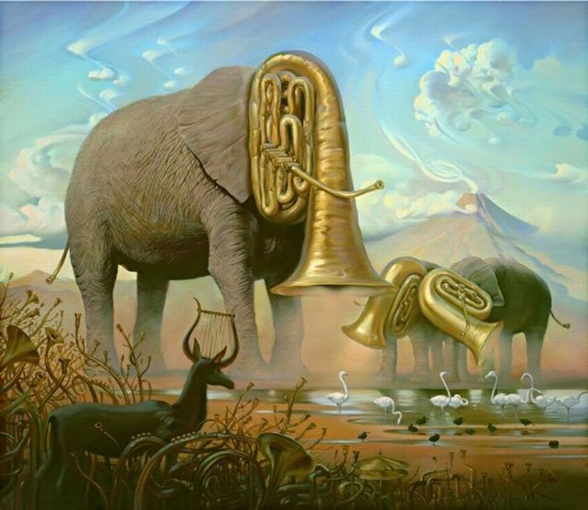
Mechanics / Progression
Creatures and Inhabitants
The player’s world will be visited by a variety of dream inhabitants.
Type is determined by environment, conditions met, etc.
Can do certain actions to get them to stay permanently in their world.
Creatures have benefits as well.
Notes:
Fantastical dreams creatures will occasionally visit the player’s dream world.
These visitors are determined by factors such as the evolving environment, hours of sleep, combination of structures, dream mood, and many others.
Users can interact with these creatures and get them to permanently stay in the world, this will usually involve some sort of quest or requirements for this to happen.
Creatures that permanently stay provide more benefits to the world, and presents a form of unique collection achievement for the user, as they can attempt to collect many different inhabitants and no two users will have the same experience and world.

Slide 13


Slide 14
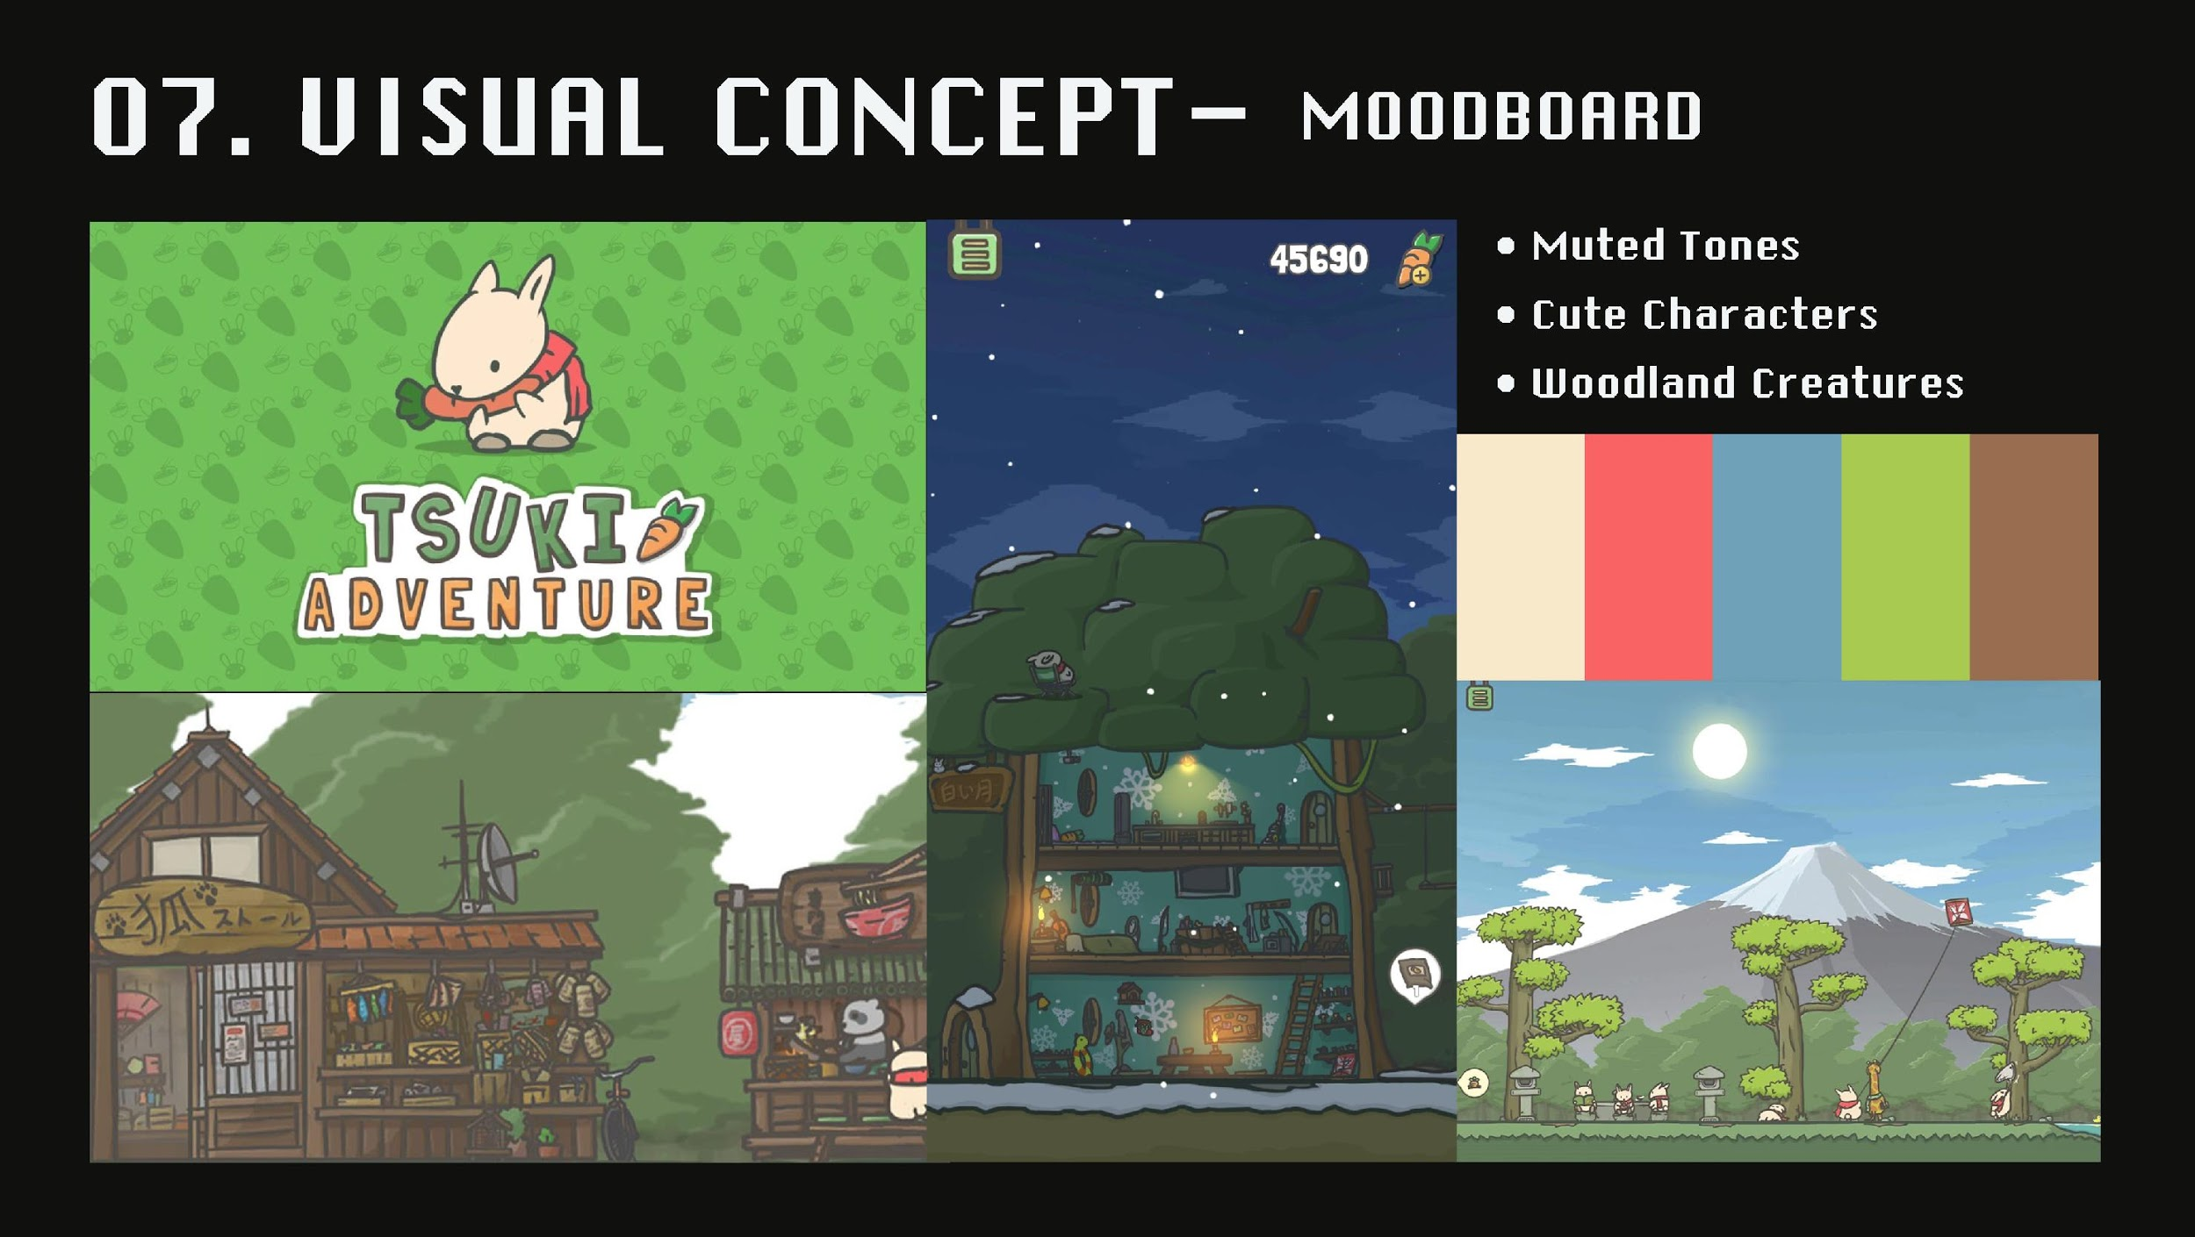
Visual Concept – Mood Board
Notes:
The world of Lucid is one of high fantasy, one with aesthetic, fantastical and surreal (but not whimsical) elements within.
The aesthetic is influenced by visual and design elements from multiple sources such as rustic fantasy and mild Japanese inspiration and sensibilities.
It is an empty, blank-slate world that evolves, with the potential to become thriving with various structures that the player can build, and inhabitants that come to visit.

Slide 15
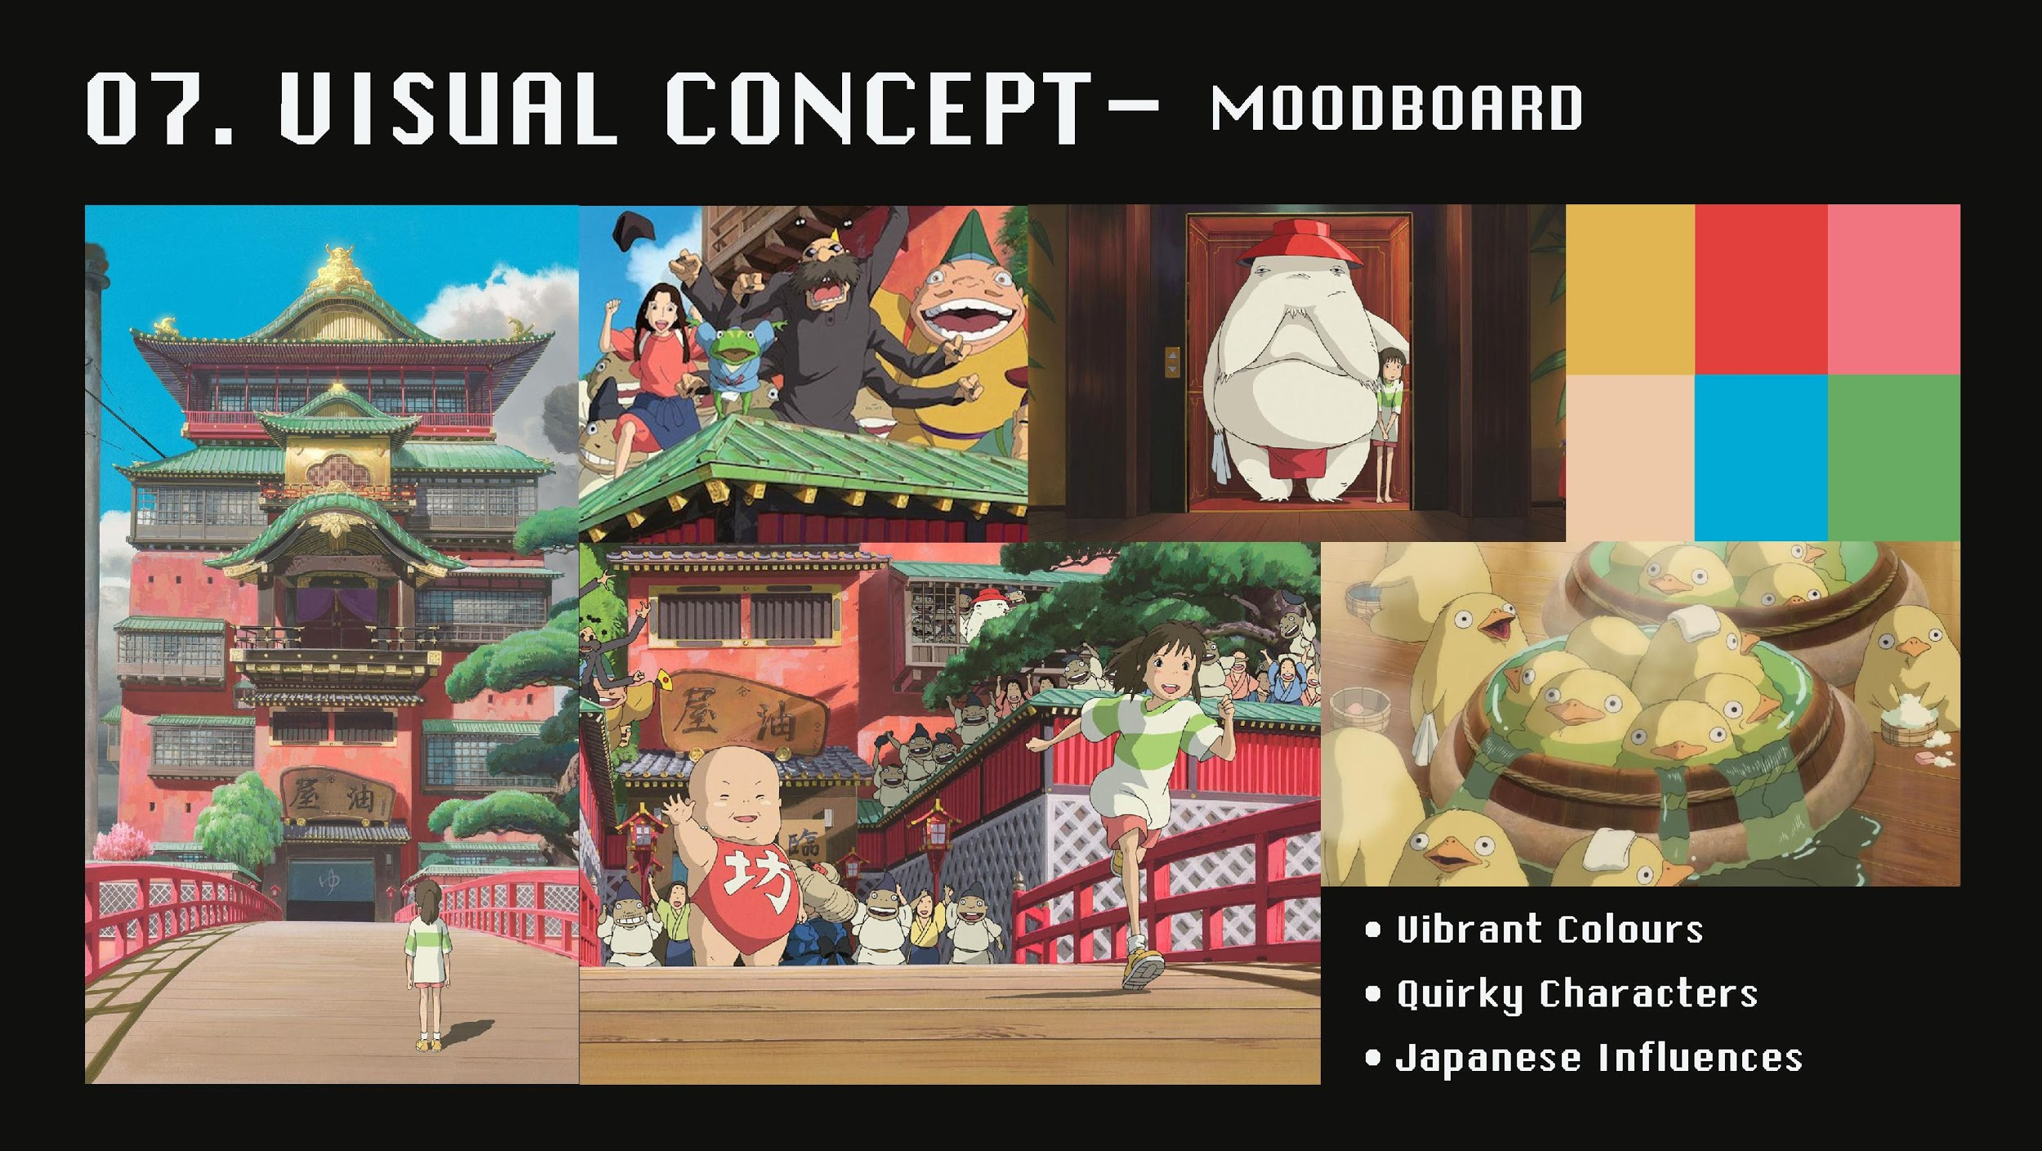
Visual Concept – Mood Board
Notes:
Another source of inspiration is Spirited Away. Overall we’re going for a stylized, simplified painterly and line art look.

Slide 16
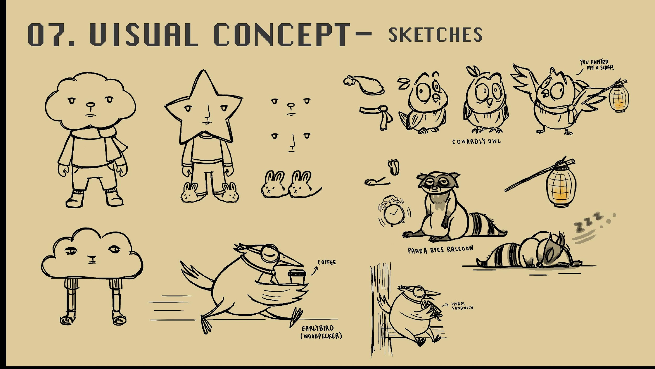
Visual Concept – Sketches
Notes:
Characters are simplified, and have clear and readable shapes. Potential dialogue may then feature a slightly more detailed profile of any characters. The idea is to create appealing, dreamy, peaceful characters to fit the overall dream/sleep theme

Slide 17


Slide 18
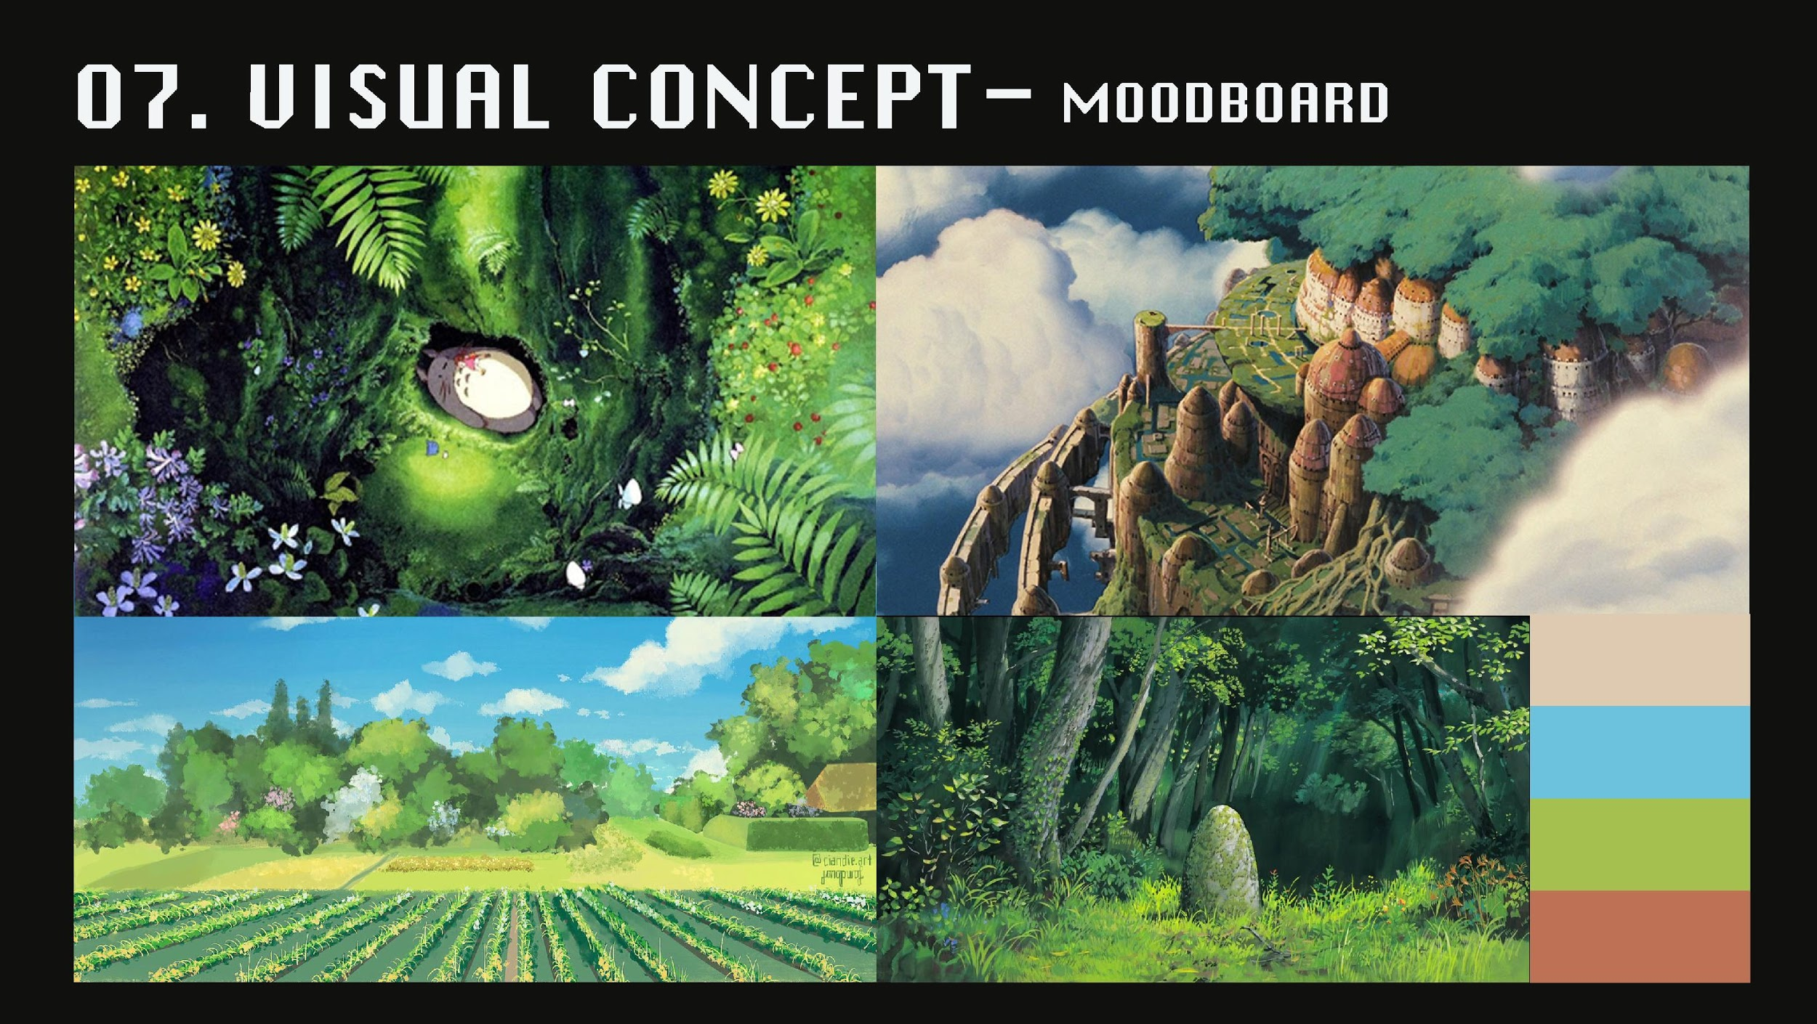
Visual Concept – Mood Board
Notes:
The environment is a living and breathing world.
Along with the inhabitants that go about their own activities, the world also experiences its own weather system (such as rain) and a day and night cycle.
Depending on the dreams of the player and their experiences, the atmosphere may also change at a whim.
The landscape to be implemented into the game is planned to be micro and focused, almost like that of a camp that the player oversees. It may be barren and simplistic at first, but it will evolve to have greenery, buildings, various decorations, and attractions and so on.

Slide 19
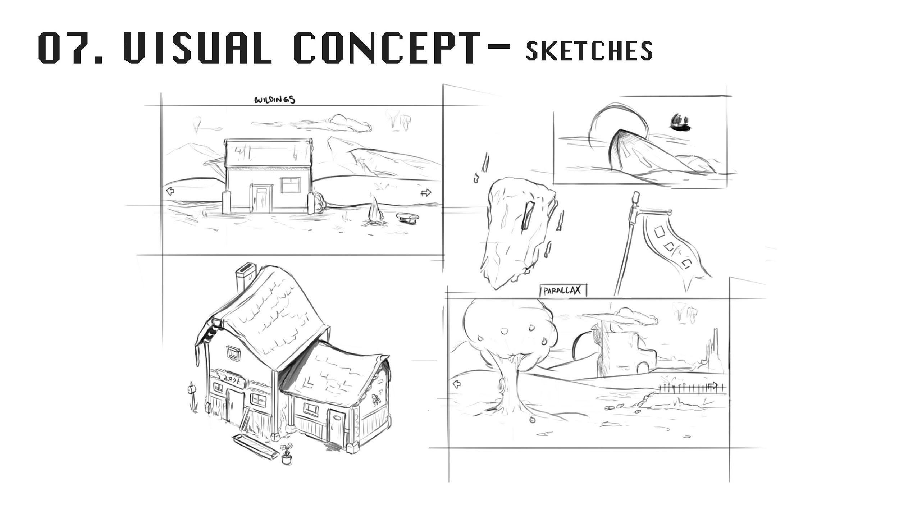
Visual Concept - Sketches
Notes:
Any planned buildings and environment itself will draw upon inspiration from a combination of rustic buildings, industrial low technology, and in some areas may instead be more magical and fantastical. It may mildly borrow from traditional Japanese influences. The aim is to create a comfortable and cozy setting for the player.
Buildings and parallax

Slide 20
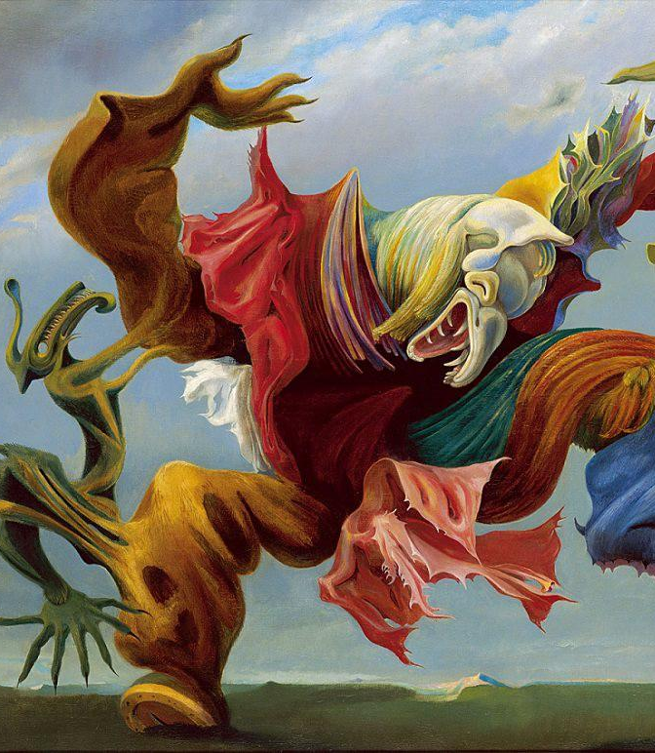
Why Is This Cool?
Actual benefits – Sleep health improvement.
Allows players to have different goals for this game:
Gain the most sleep points.
Improve their actual real life sleep with this game as motivation.
Create the coolest dream world.
Collect the most variety of dream creatures.
Lets the player have a connection to their real dream world via their personalized game world that evolves overtime.

Slide 21
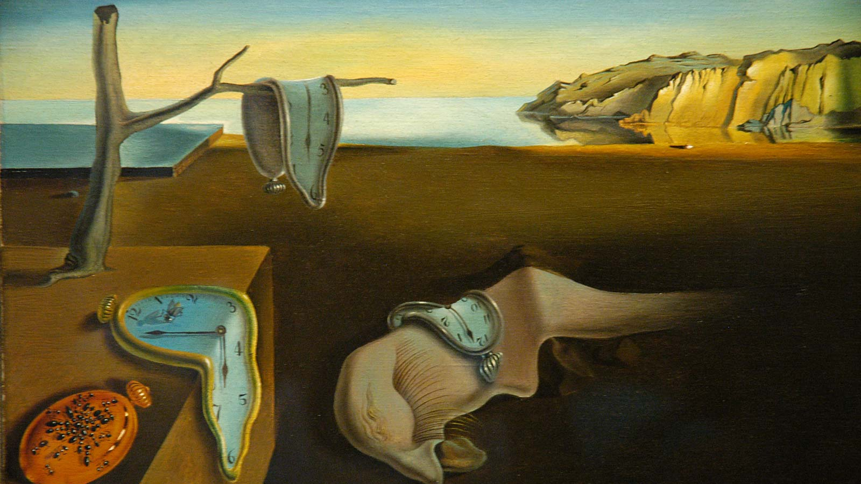
Thanks for Your Time!

